Slide 1
Customer Churn
By Wali Mohamed

Slide 2
Business Problem
A banks wants to predict customer churn
It helps them take action to prevent it
They may give them offers and discounts
High recall is more important.

Slide 3
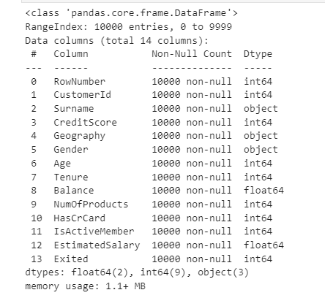
Data Analysis
10,000 rows
14 columns

Slide 4
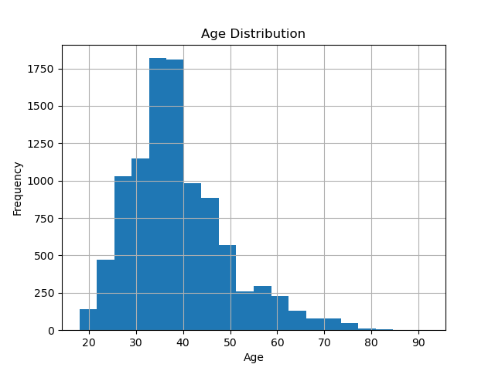
Distribution by Age
Most were between 30 and 40

Slide 5
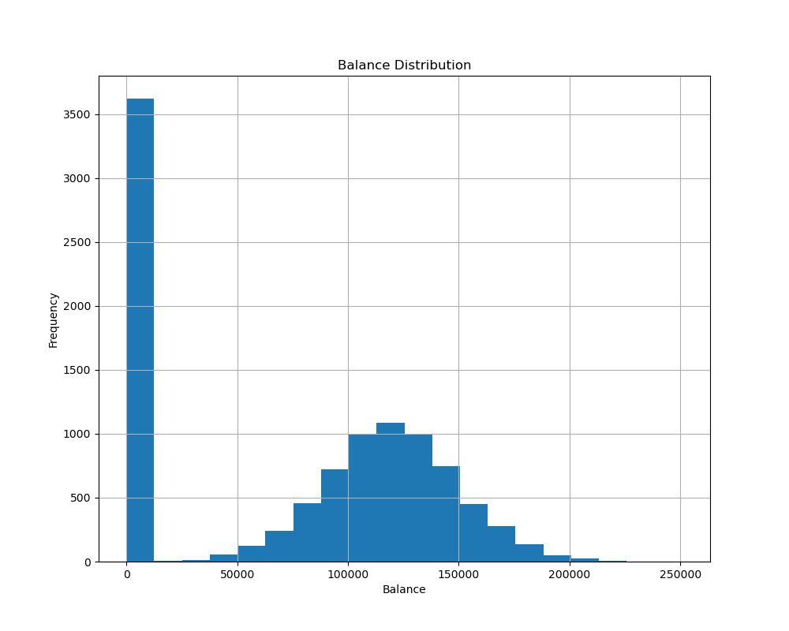
Distribution by Account Balance
Normally distributed

Slide 6
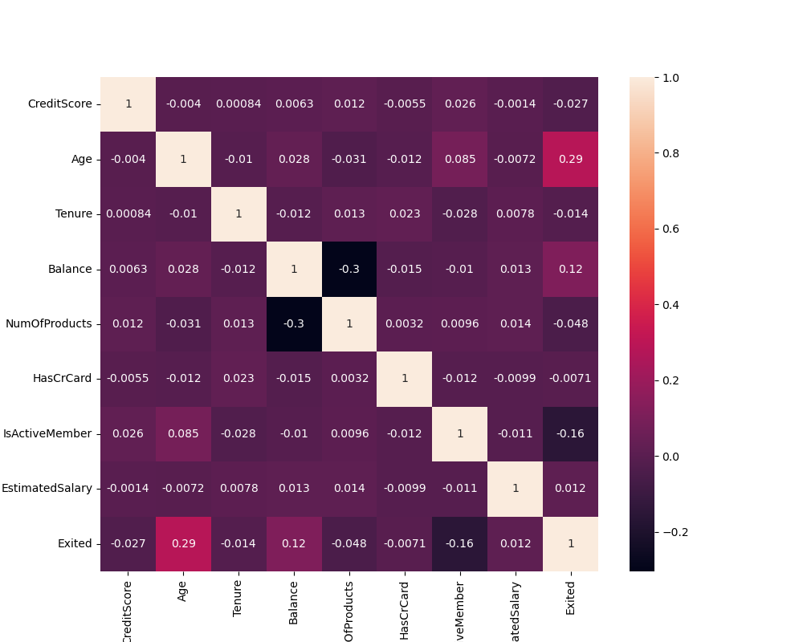
Correlation

Slide 7
Logistic Regression Results
Logistic Regression | Model Regular | Undersampling | Oversampling
Training Score | 81% | 71% | 71%
Testing Score | 81% | 70% | 70%
Precision | 56% | 37% | 36%
Recall | 20% | 71% | 70%

Slide 8
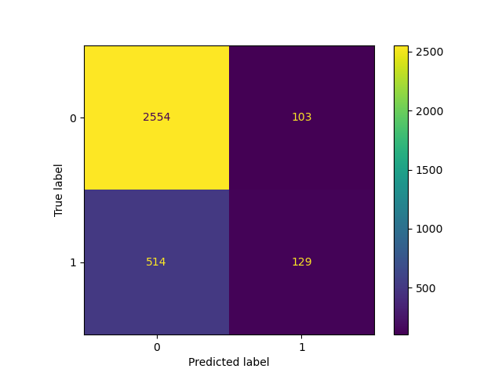
Confusion Matrix Display
Regular Model

Slide 9
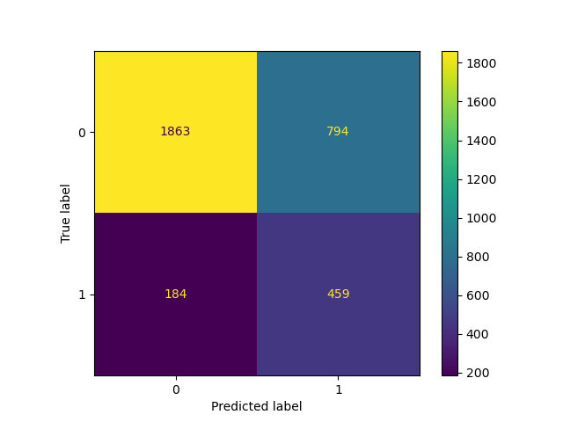
Confusion Matrix Display
Undersampled Model

Slide 10

Confusion Matrix Display
Oversampled Model

Slide 11
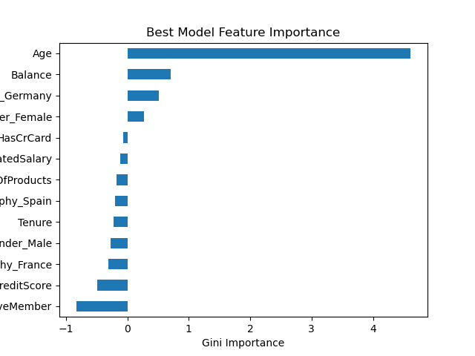
Feature Importances
Contribution of each category

Slide 12
Conclusion
Use under sampling on Logistic Regression

